Slide 1
Tech Design Document
Alejandro Giralt

Slide 2
Introduccion
The Technical Design Document provides a blueprint for the software engineers in your team to implement and code the features of your game.
The primary function is to communicate the technical details of the work to be done to members of the team.
Useful document to show when it comes to find a publisher for your game.

Slide 3
Relation with the GDD
The GDD allows game developers to administrate and organize their ideas
The TDD defines all the technical aspects of the features which are defined in the GDD

Slide 4
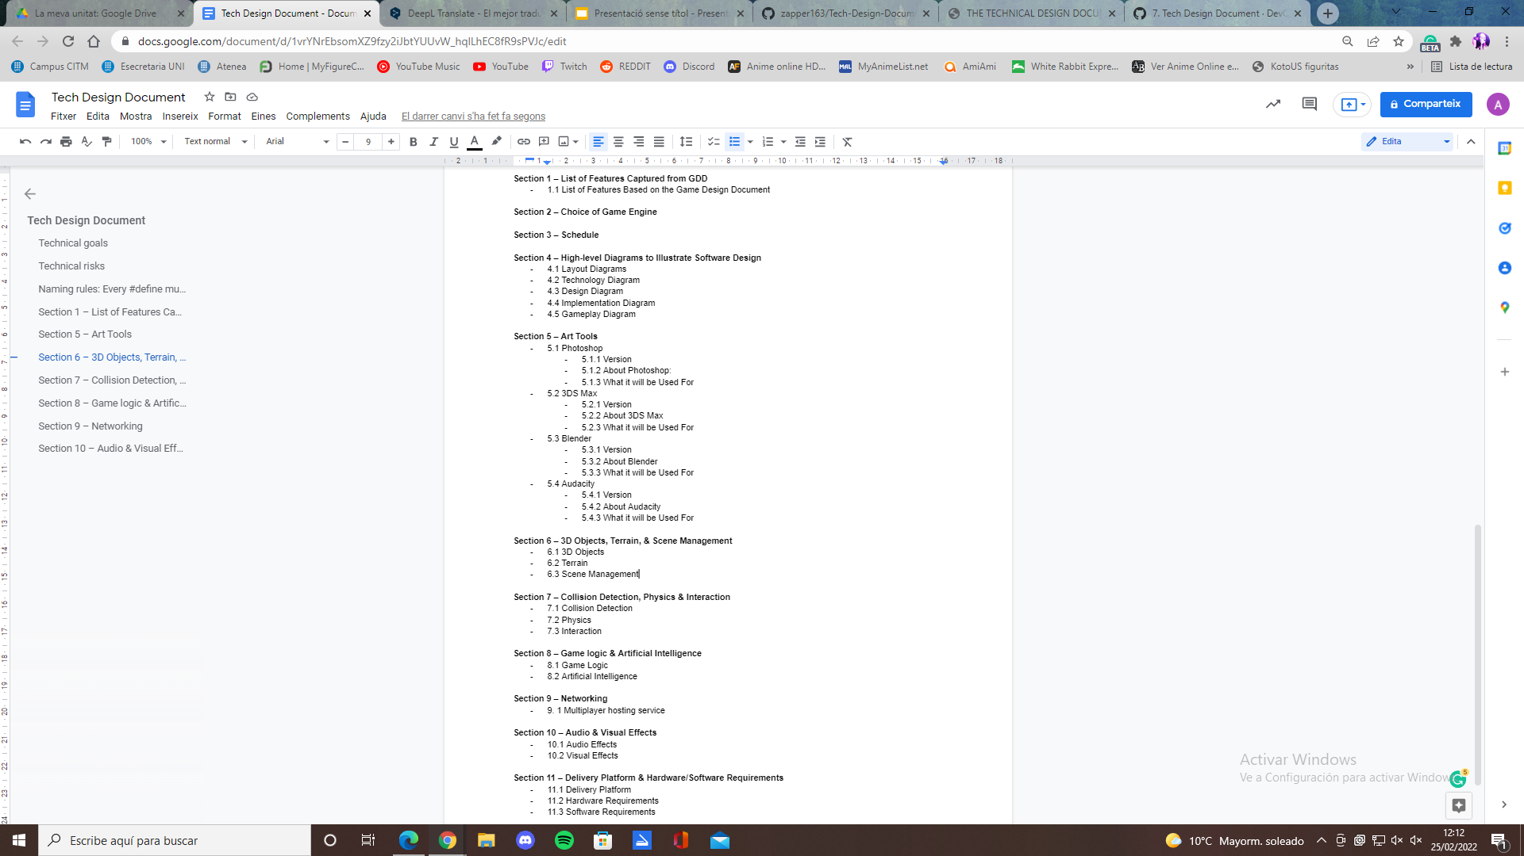
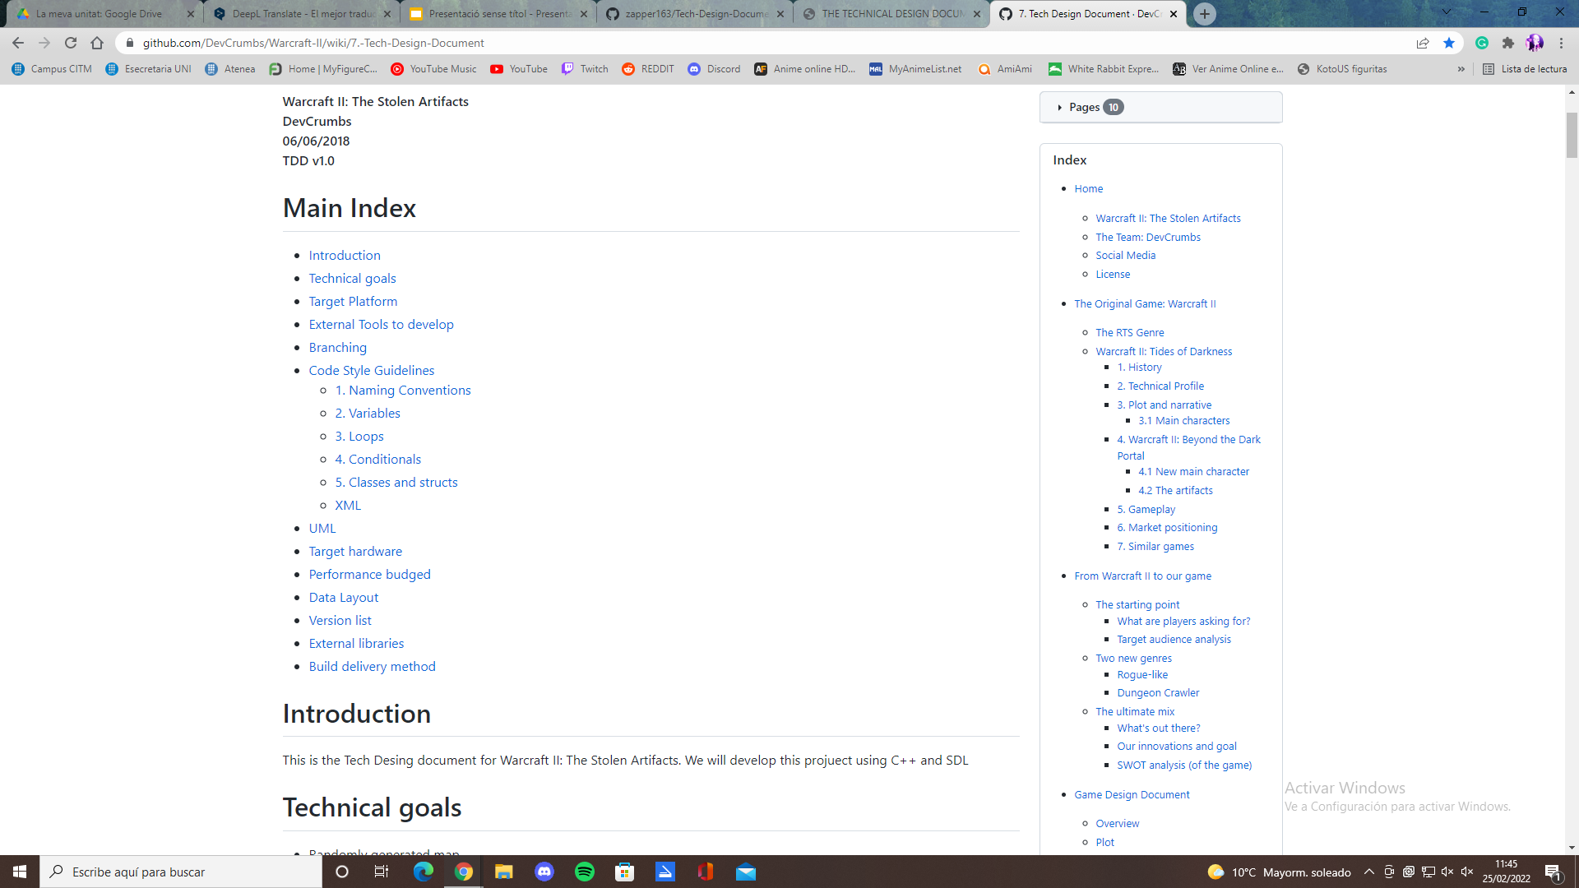

Slide 5
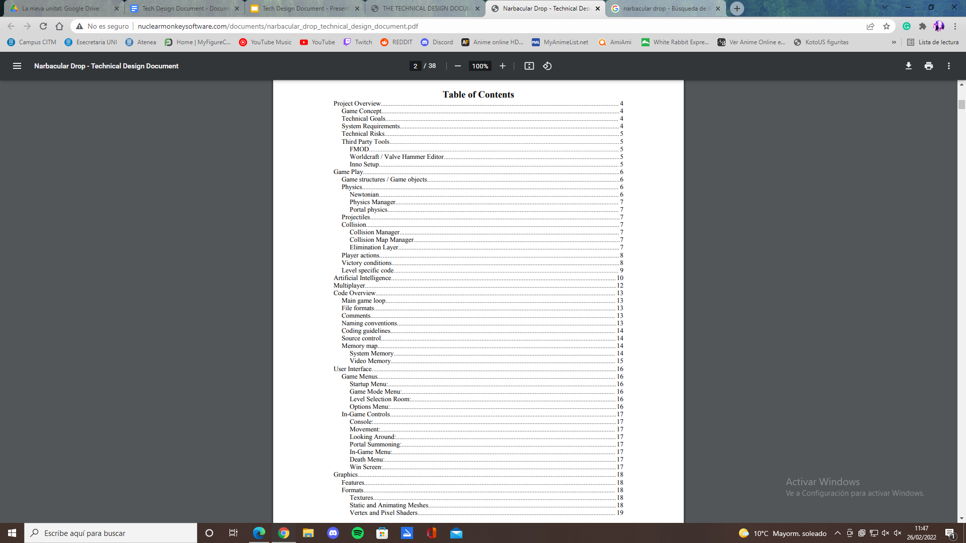
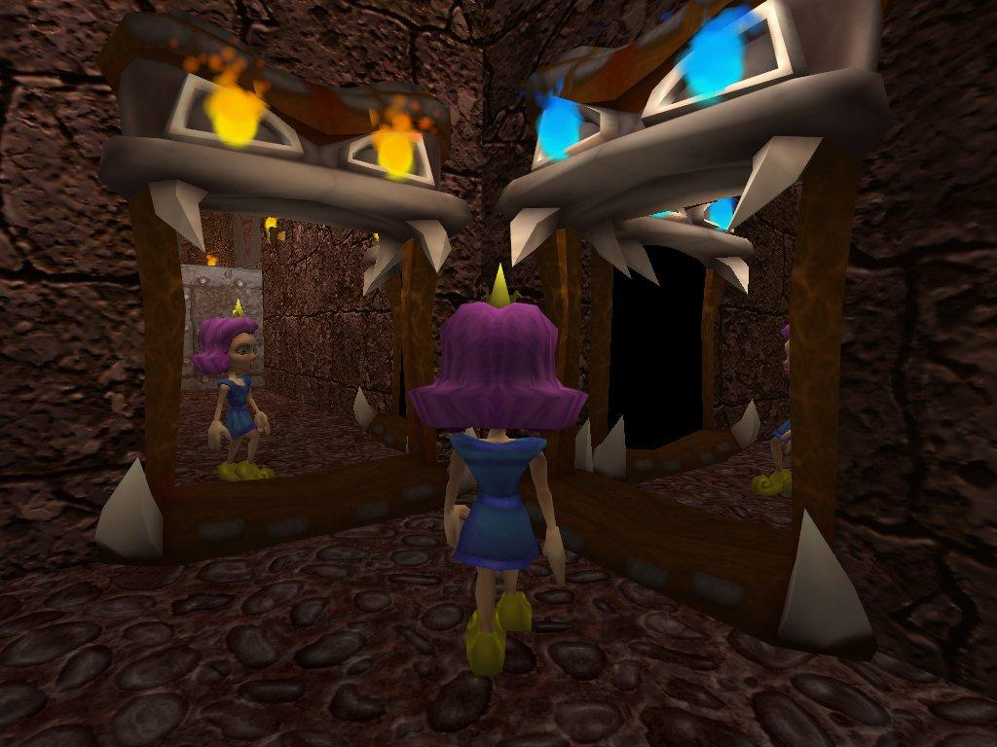
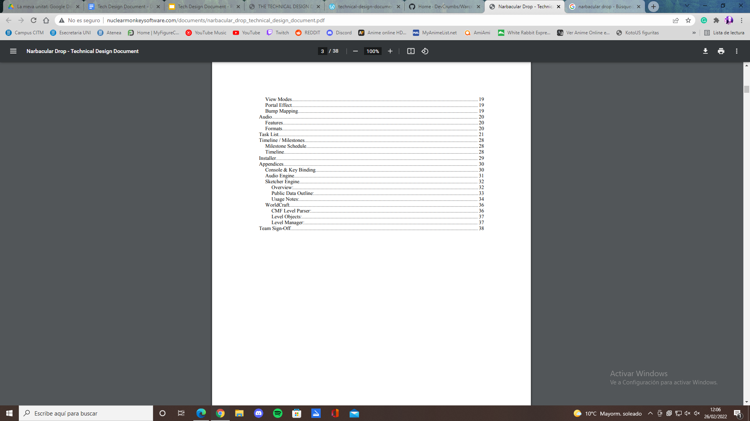
Narbacular Drop

Slide 6
Content
Project Overview
Gameplay
Code Overview
TaskList
Choice of Game engine
Use of Physics Engine
Artificial Intelligence
Graphics
Audio
Networking

Slide 7
Project Overview
Code Overview
Gameplay
Task List
Features from the GDD
Technical goals
Technical risks
Delivery platform
Main Game loop
Branching
Naming conventions
Coding guidelines
Performance Budgets
Game structures/Objects
Physics
Collisions
Player actions
Level specific code
Milestone schedule
Timeline/Version list

Slide 8
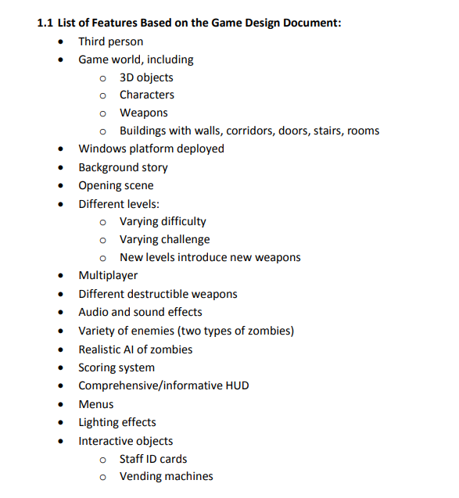
Project Overview: Game Concept
“The player is a princess stuck in a dungeon-like atmosphere where she must solve puzzles with the use of her ability to summon a single set of linked portals on earthen walls and floors/ceilings”

Slide 9
Project Overview: Technical Goals
Immersive 3D ambient sound.
Realistic physics.
Complex A.I.
Realistic Shadows

Slide 10
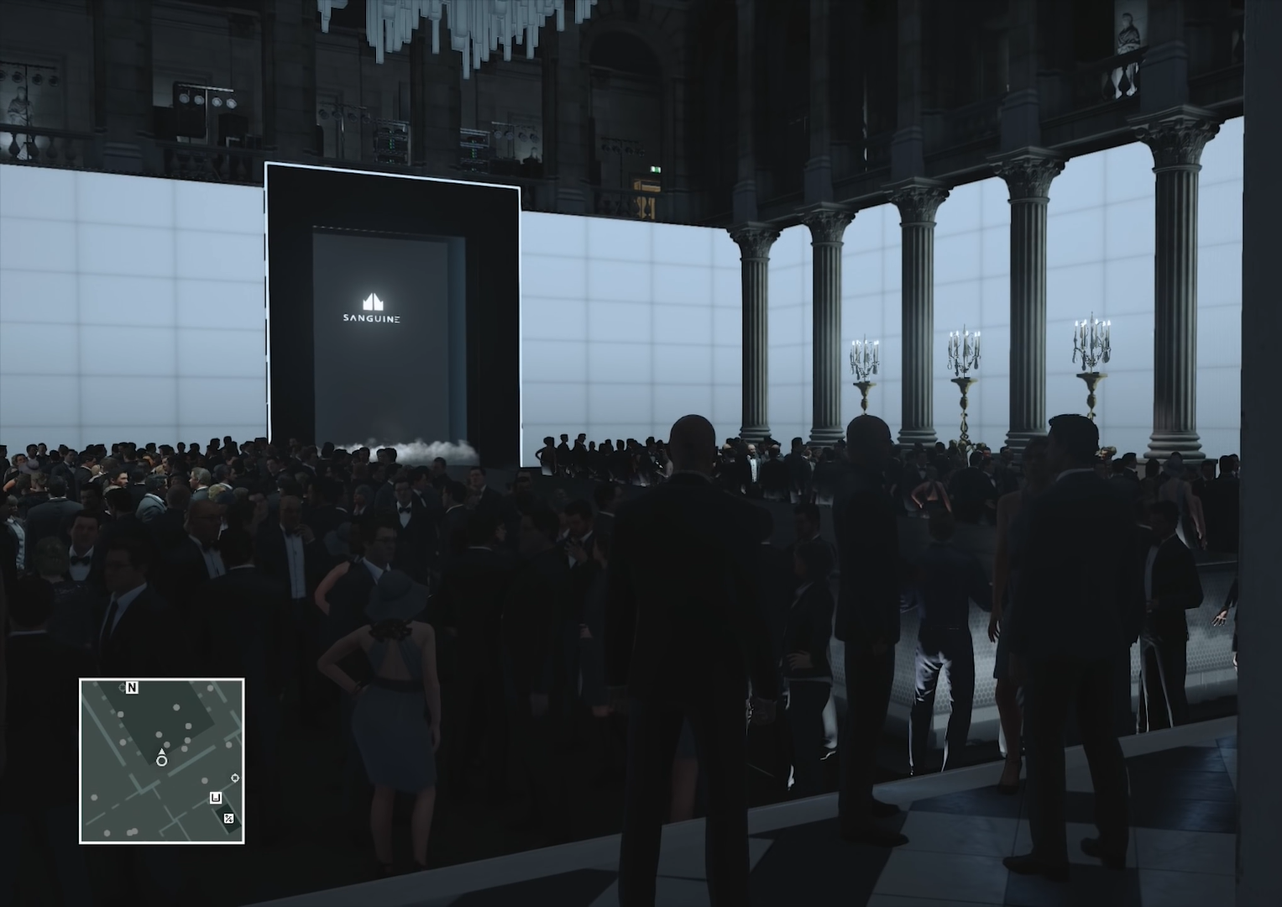
Project Overview: Technical Risks
Portal technology could break or be horribly slow on some hardware.
Complications with portal technology could bring about large amounts of hacks, counter-hacks, and cross-hacks.
FMOD could suddenly change their licensing and we'd have to make time to create a robust sound system.
The entity system could have some crippling fault that we haven't thought of yet.
Hitman

Slide 11
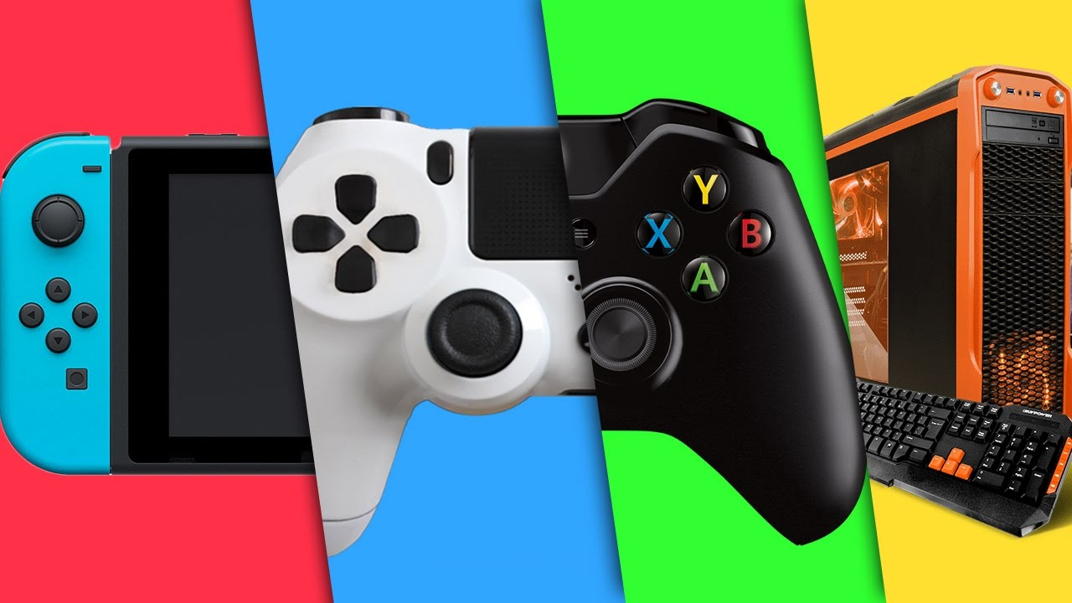
Project Overview: Delivery Platforms

Slide 12
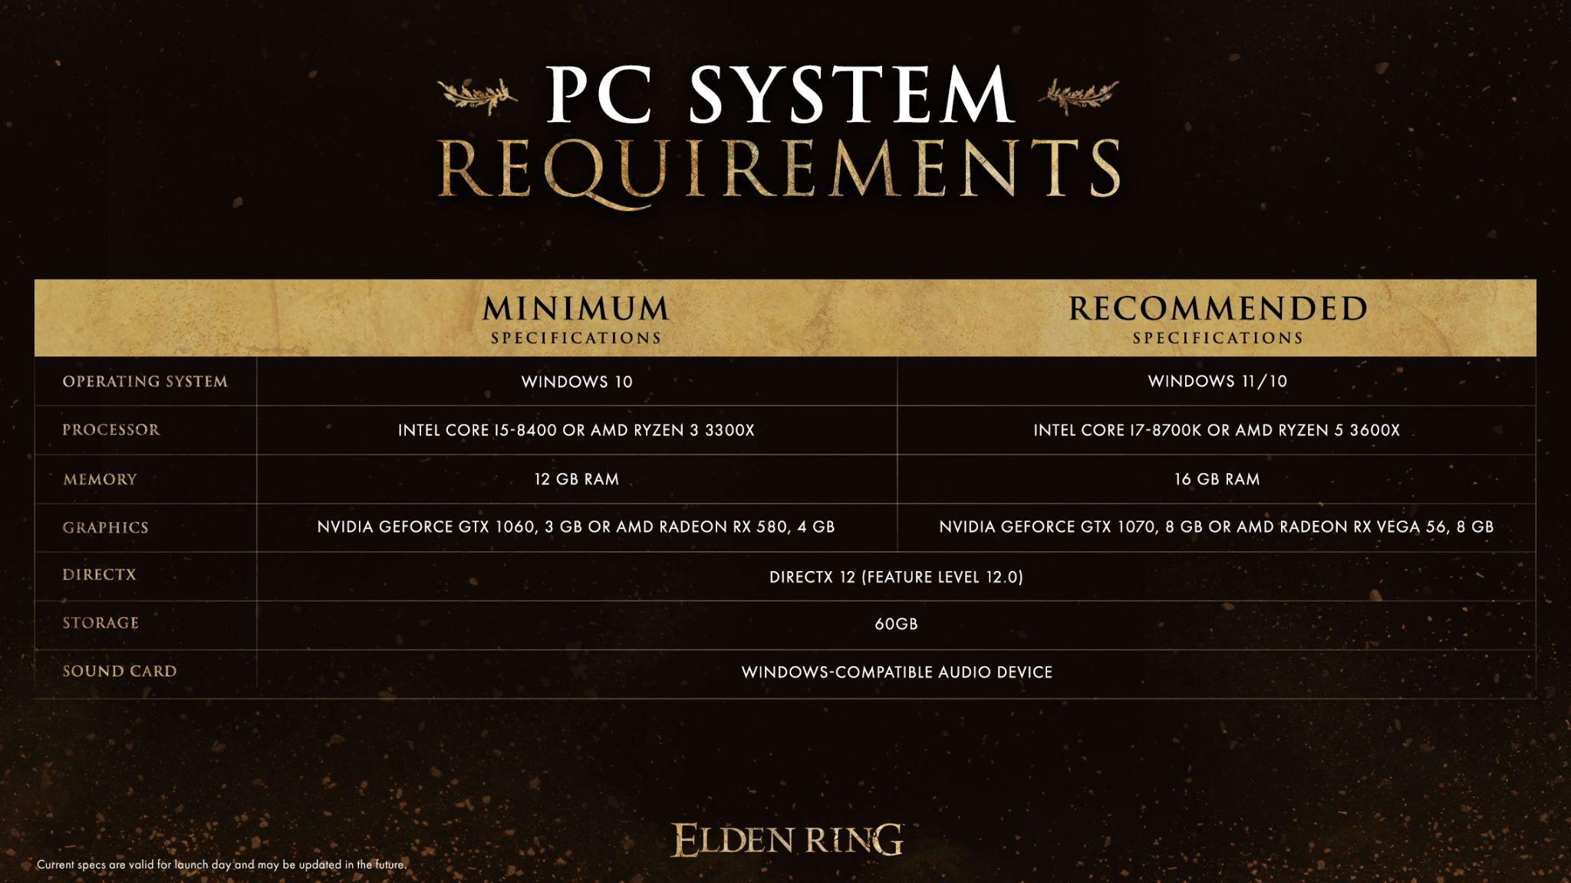
Project Overview: System Requirements

Slide 13
Project Overview
Code Overview
Gameplay
Task List
Features from the GDD
Technical goals
Technical risks
Delivery platform
Main Game loop
Branching
Naming conventions
Coding guidelines
Performance Budgets
Game structures/Objects
Physics
Collisions
Player actions
Level specific code
Milestone schedule
Timeline/Version list

Slide 14
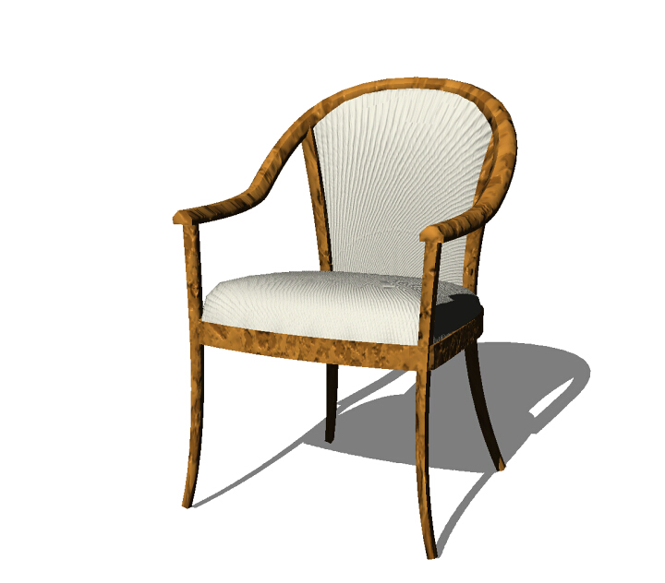
Gameplay: Game Structures/Objects
Wall
Button: A button that you usually need to press to open a door.
Door: The doors at the end of each level.
Lava
Lava heater
Crate: Generic crates that are nothing more than weights.
Fireball
Torch: Lighting coolness.

Slide 15

Gameplay: Physics/Collisions
The mass (kg) of the object.
The ratio of energy it loses on impact. So 0.1 is very rubbery and 0.9 is very sticky.
Current velocity (m/s).
Gravity acceleration that is applied every frame. By default it's 9.8 (m/s^2).
The velocity is capped at the maximum value 80 m/s

Slide 16
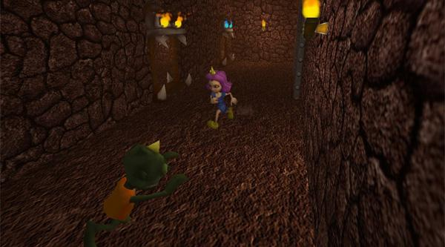
Gameplay: Player Actions
The player is capable of the following actions:
Creating 2 interlinked portals
Walking around.
Looking around her environment.
Falling.
Walking into a portal
It should be noted that the player is NOT capable of jumping or pushing objects around the world.
Narbacular Drop

Slide 17
Gameplay: Level Specific Code
Level 1 - Code required:
Detection for when all 3 buttons have been pressed at the same time and the door needs to be opened.
Specialized A.I. for Impy.
Wally hint conditions and sequences.

Slide 18
Project Overview
Code Overview
Gameplay
Task List
Features from the GDD
Technical goals
Technical risks
Delivery platform
Main Game loop
Branching
Naming conventions
Coding guidelines
Performance Budgets
Game structures/Objects
Physics
Collisions
Player actions
Level specific code
Milestone schedule
Timeline/Version list

Slide 19
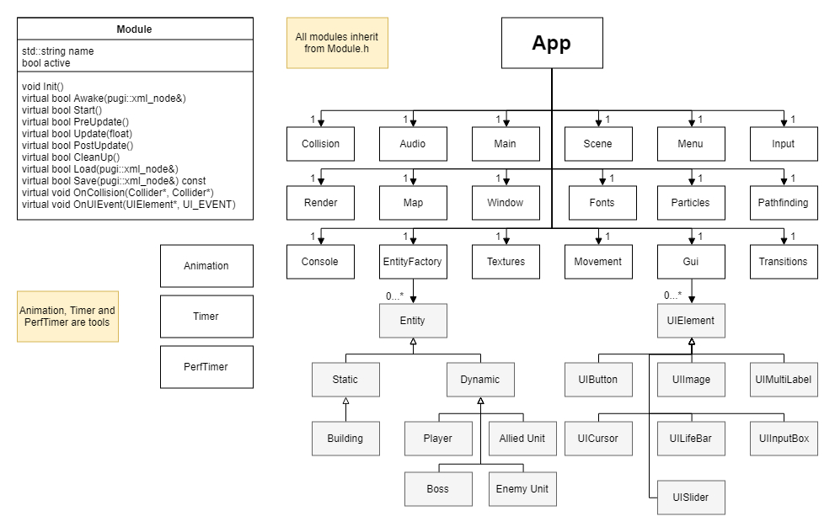
Code Overview: Main Game Loop (UML)

Slide 20
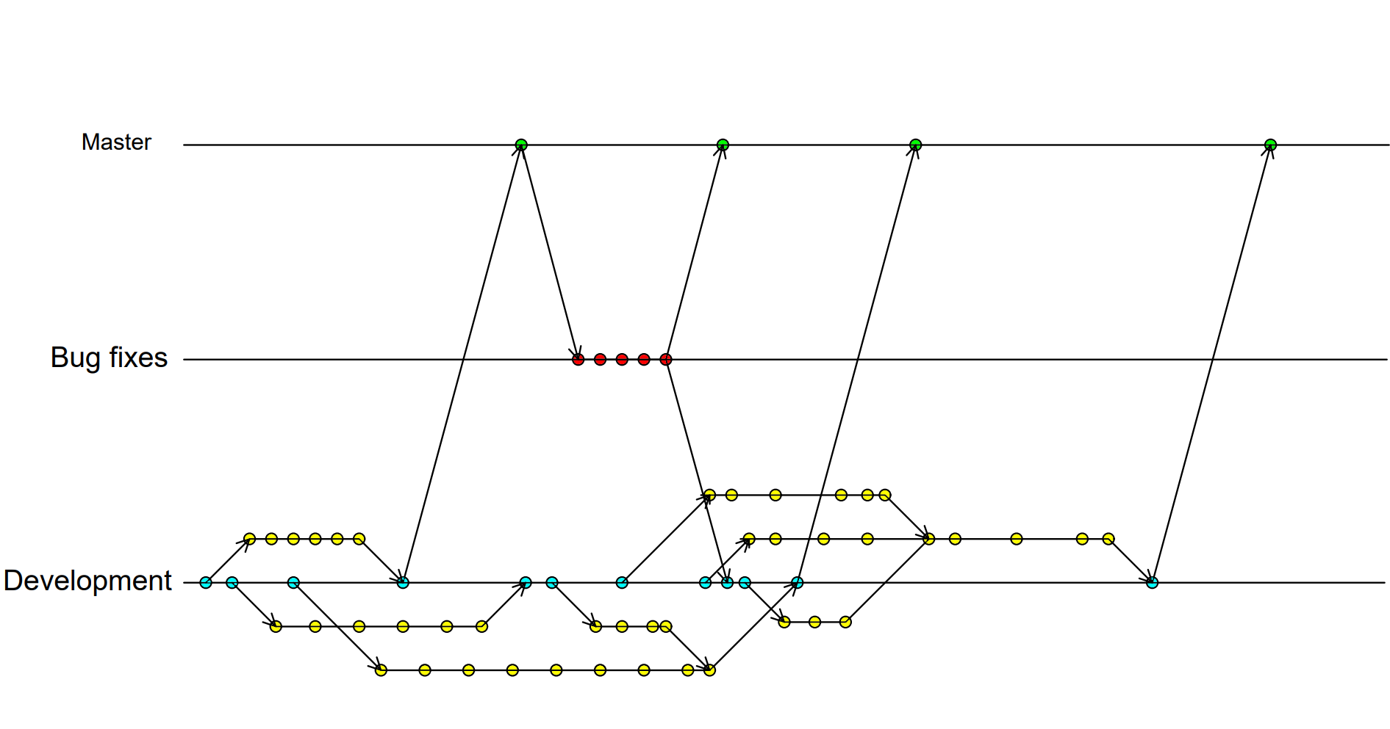
Code Overview: Branching

Slide 21
Code Overview: Naming conventions/Coding guidelines
Every #define must be in capital letters:
#define MAX_HP 300
Every time a pointer is created must be initialized as null:
int* test = nullptr;
We prefer a conditional like if(something) {}
rather than one like if(something == true) {}
If a node has just one attribute we'll declare it in the same line:
<house colour="red"/>

Slide 22
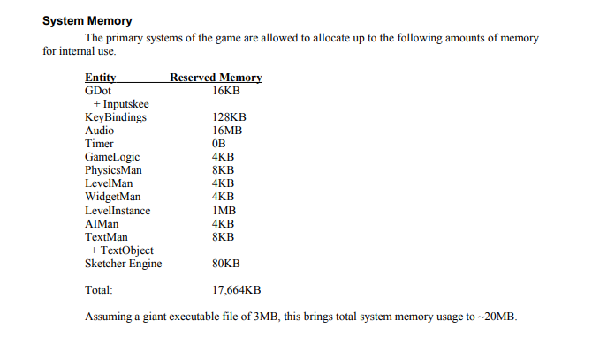
Code Overview: Performance budgets

Slide 23
Project Overview
Code Overview
Gameplay
Task List
Features from the GDD
Technical goals
Technical risks
Delivery platform
Main Game loop
Branching
Naming conventions
Coding guidelines
Performance Budgets
Game structures/Objects
Physics
Collisions
Player actions
Level specific code
Milestone schedule
Timeline/Version list

Slide 24
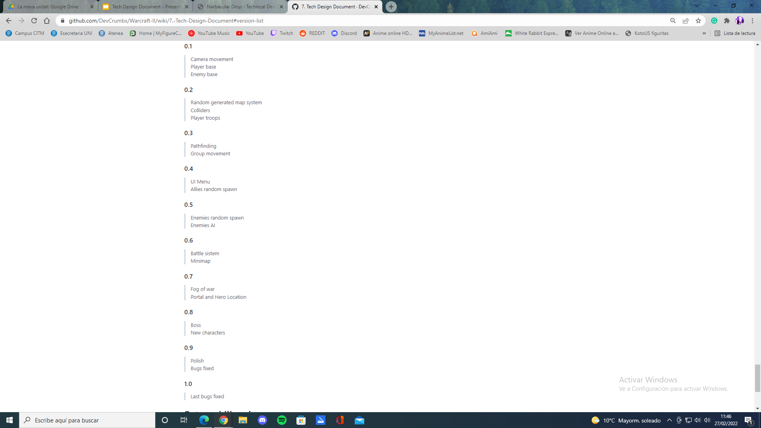
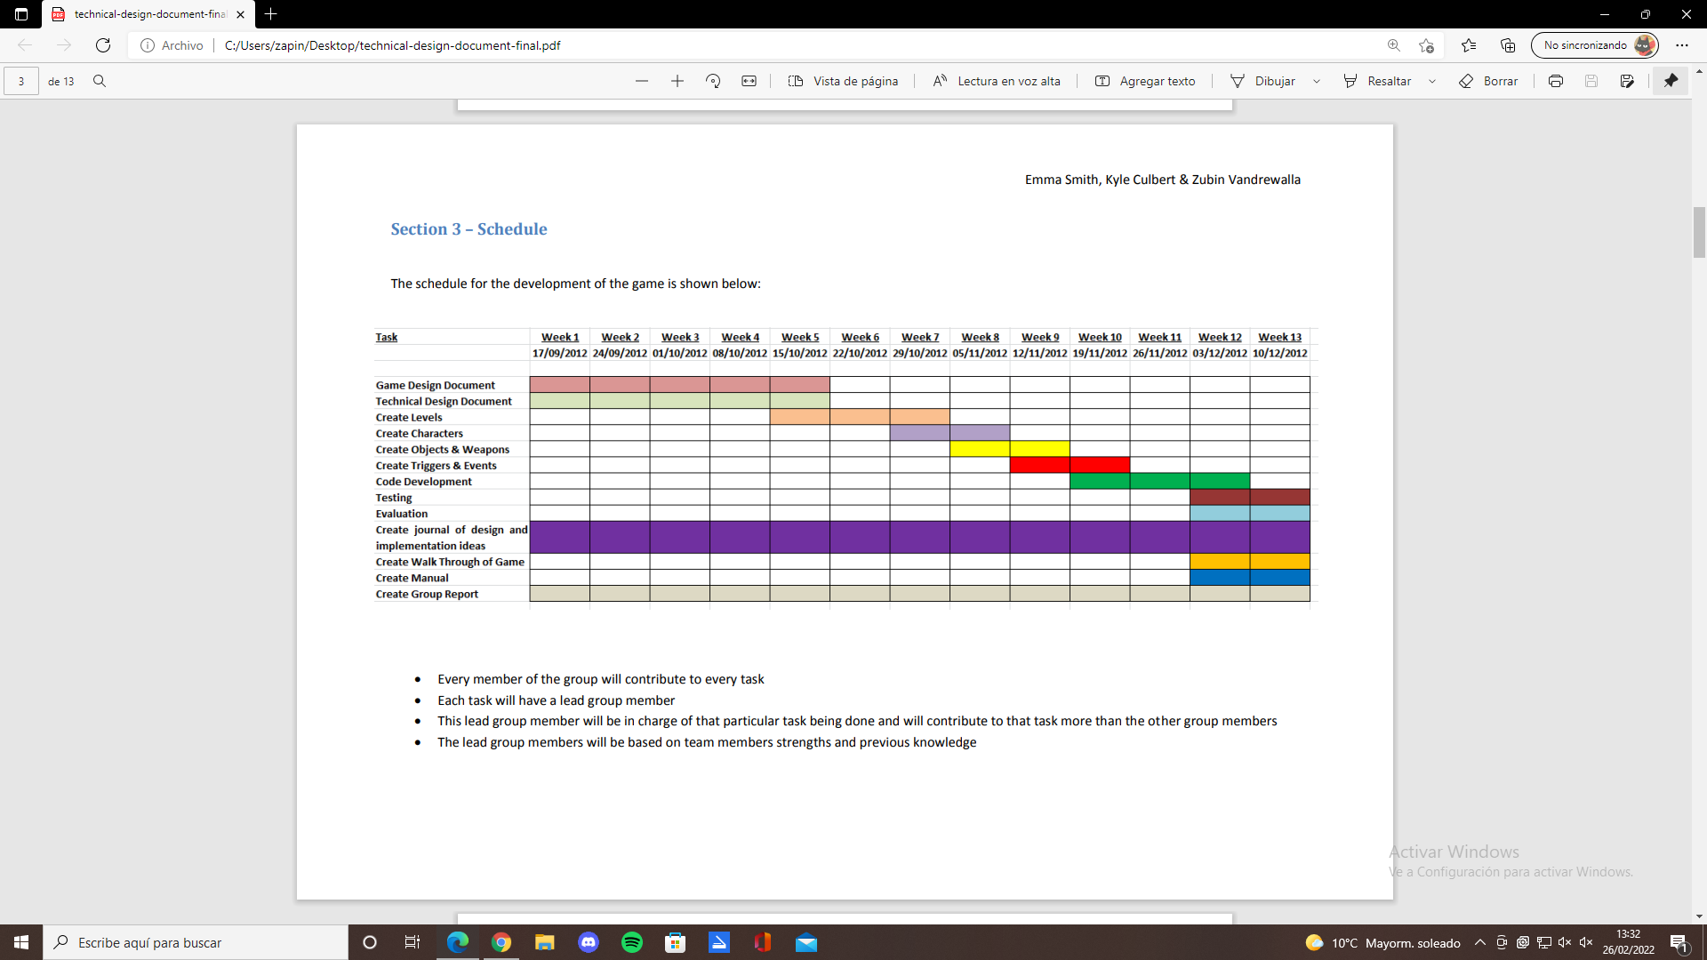
Task List: Milestone Schedule/Version List

Slide 25
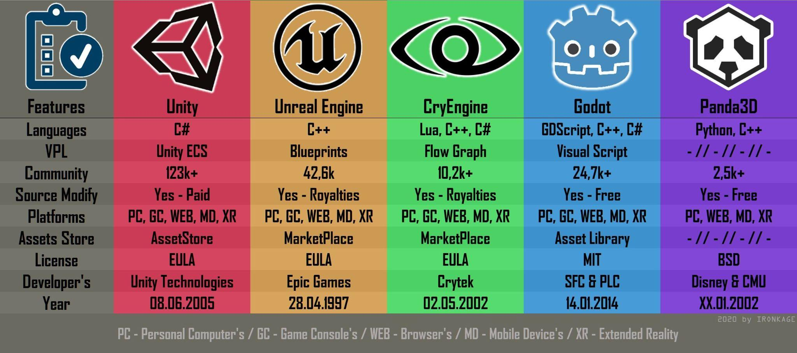
Extra sections: Choice/Use of Game engine

Slide 26

Extra sections: Choice/Use of physics engine

Slide 27


Extra sections: External Libraries

Slide 28
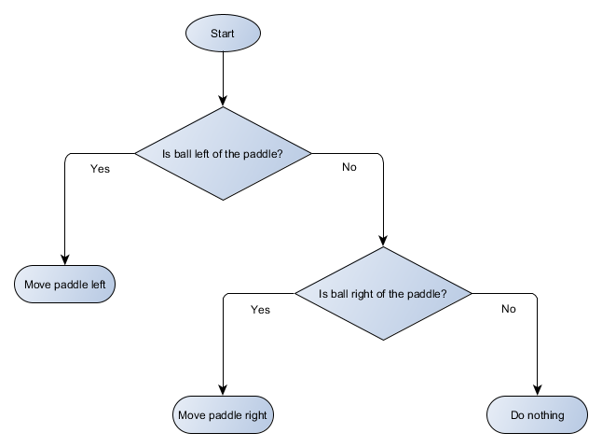
Extra sections: Artificial Intelligence

Slide 29
Extra sections: Graphics
Features Format View Mode
First person.
Third person follow-cam.
Third person static camera positions specified by level.
Automatically finds the fastest possible configuration for any given display mode
All meshes must be in Direct3D's "X" format.
Direct3D

Slide 30
Extra sections: Audio
Features Format
2D/3D sound effects.
2D music with support for compressed file formats.
MOD/S3M/XM, MIDI, WAV
FMOD

Slide 31
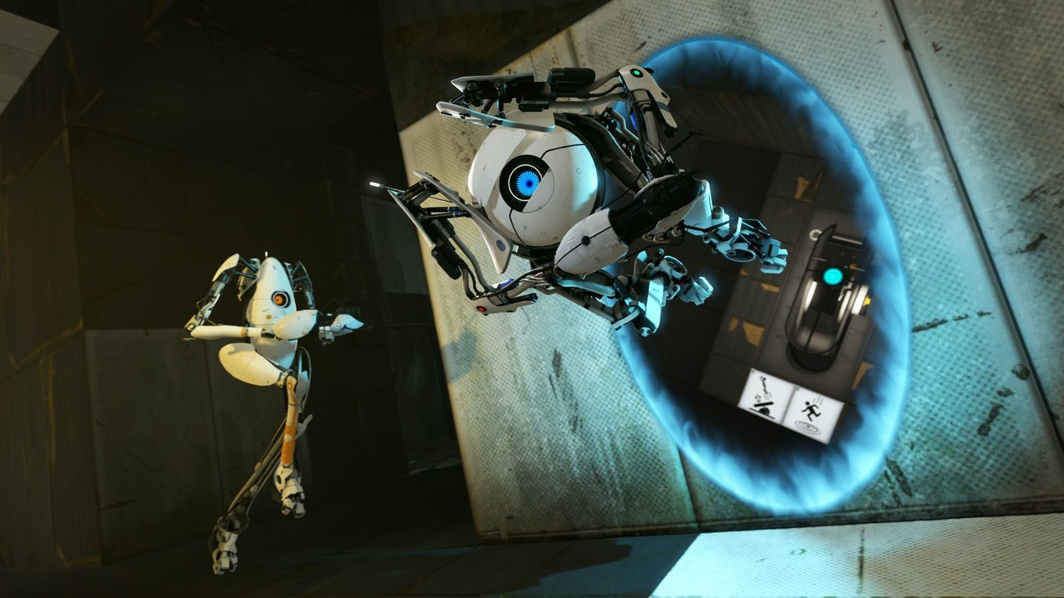
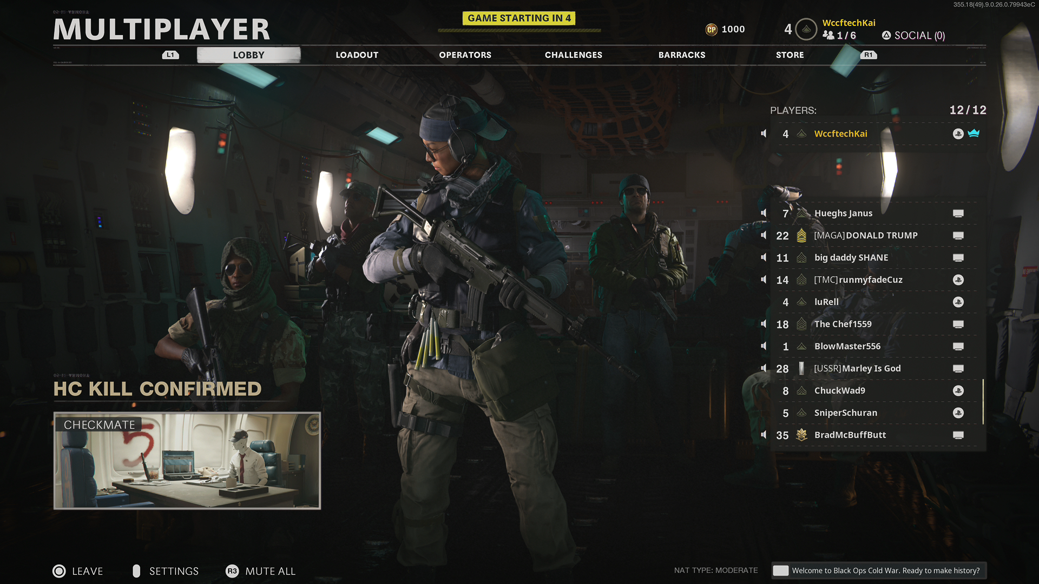
Extra sections: Networking
Portal
CoD Cold War

Slide 32
Project Overview
Code Overview
Gameplay
Task List
Features from the GDD
Technical goals
Technical risks
Delivery platform
Main Game loop
Branching
Naming conventions
Coding guidelines
Performance Budgets
Game structures/Objects
Physics
Collisions
Player actions
Level specific code
Milestone schedule
Timeline/Version list

Slide 33
Nuestro TDD:
Game Concept
Technical goals
Technical risks
RPG game with open-world isometric view and turn-based combat
Turn-based combat where you can control 4 different characters at the same time
Errors when joining Box2D with Tiled
Problems with the turn system

Slide 34
Nuestro TDD:
Naming Guidelines
External libraries
Performance budgets
Every #define must be in capital letters.
Every game-related file must be named using capitals and underscores instead of periods or spaces or slashes: asset_plant
SDL for graphics.
Box2D for collisions.
The game runs at 60 frames per second

Slide 35
Nuestro TDD:
Build delivery method
Delivery platform
GitHub
PC, with mouse and keyboard or gamepad

Slide 36
Game concept
Technical goals
Technical risks

